Slide 1
LEARNING & Development
FAQ HIGHLIGHTS
Notes:
Learning & Development

Slide 2
L & D – FAQ HIGHLIGHTS
WHERE DO YOU FIND THE L&D FAQS
AND PROCESSES ?
???

Slide 3
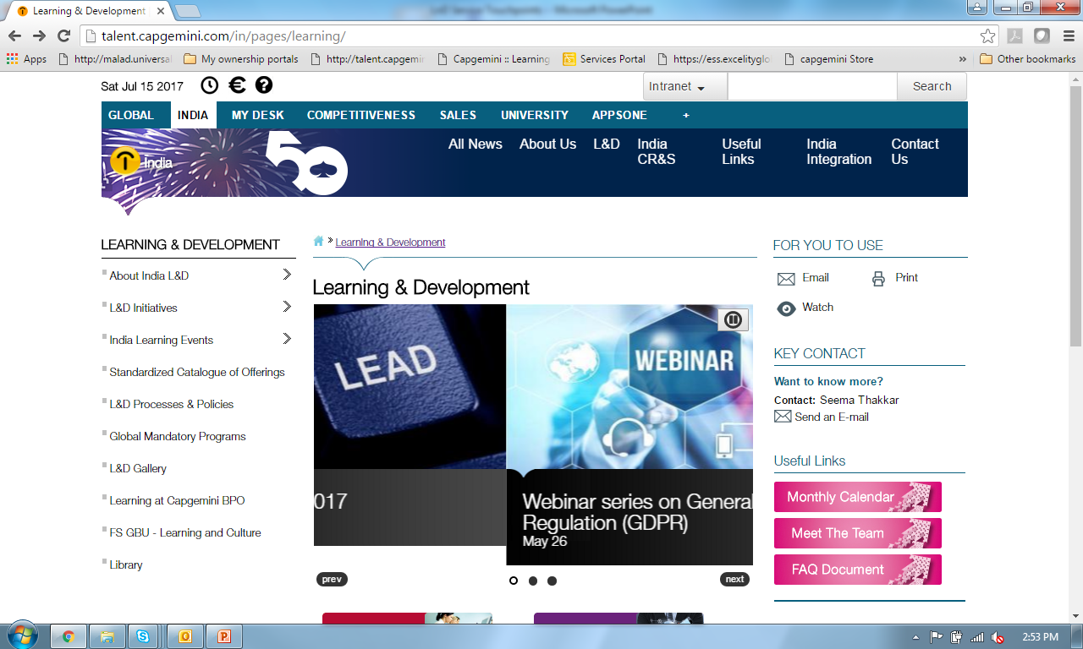
TALENT PAGE

Slide 4
L & D – FAQ HIGHLIGHTS
WHERE DO YOU FIND LND HELPDESK FOR RAISING A QUERY ?
???
Please mail to INLNDTSOS.IN@capgemini.com with queries. Send screen shot where ever possible.

Slide 5
L & D – FAQ HIGHLIGHTS
Do you want to know where to check for a training program for you ?
Your Mailbox :
Monthly Calendar sent by INLND@CAPGEMINI.COM (IN, LnD)
Talent Page :
Calendar available on Talent Portal >>> India Page >>> LnD page
Please refer to the L&D Processes & Policies section on Talent portal for any process related query.
(Talent > L&D > L&D Process & Policies)
Please refer to FAQ on Talent portal for any other query.
Notes:
Learning & Development

Slide 6
L & D – FAQ HIGHLIGHTS
Whom should you connect with for new training requirements
You can connect with your N+1 and it would be routed through Learning Business Partner (LBP) to address your learning need
Please note that employees should have Manager & above approval for the project / BU specific training)
Please refer to the L&D Processes & Policies section on Talent portal for any process related query.
(Talent > L&D > L&D Process & Policies)
Please refer to FAQ on Talent portal for any other query.
Notes:
Learning & Development

Slide 7
L & D – FAQ HIGHLIGHTS
How do you Nominate / Register for a calendar program ?
Click on the link embedded in LnD calendar
(course name is hyperlinked)
Please refer to the L&D Processes & Policies section on Talent portal for any process related query.
(Talent > L&D > L&D Process & Policies)
Please refer to FAQ on Talent portal for any other query.
Notes:
Learning & Development

Slide 8
L & D – FAQ HIGHLIGHTS
What if you want to know more about training costs & certification reimbursement
All training cost will be debited against the BU LnD code to which the employee belongs. The cost of training is not deducted from participant’s salary.
The training cost for a program can be seen on MyLearning while registering for a program
LnD has an elaborate process for certification reimbursement –
Please read the process document
Please refer to the L&D Processes & Policies section on Talent portal for any process related query.
(Talent > L&D > L&D Process & Policies)
Please refer to FAQ on Talent portal for any other query.
Notes:
Learning & Development

Slide 9
L & D – FAQ HIGHLIGHTS
How to get a Training Project code for filling time sheets:
The code for timesheet will be available with the BU Resource Management Group (RMG) SPOC
Please refer to the L&D Processes & Policies section on Talent portal for any process related query.
(Talent > L&D > L&D Process & Policies)
Please refer to FAQ on Talent portal for any other query.
Notes:
Learning & Development

Slide 10
L & D – FAQ HIGHLIGHTS
What if you face technical issues regarding/during virtual training
If you are attending from your desk, you need to get in touch with your local ITICS engineer to get this resolved.
However, for all setups in a L&D lab / classroom, L&D coordinator for the location will get it resolved through the ITICS team
For example, if your Skype meeting is not working.
Please log a call with the India Service Desk under > Request Service > Lync/GIMS/Live Meeting
And contact your local ITICS team.
Please refer to the L&D Processes & Policies section on Talent portal for any process related query.
(Talent > L&D > L&D Process & Policies)
Please refer to FAQ on Talent portal for any other query.
Notes:
Learning & Development

Slide 11

HAPPY LEARNING

